Slide 1
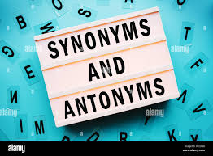

Slide 2
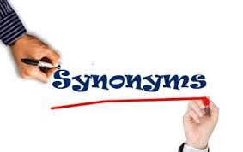

Slide 3
What is a synonym?
A synonym is a word that has a similar meaning to another.
Example.
good
fine
okay
Similar means almost the same but with a small difference.
Can you describe the difference between the words?

Slide 4
How can we use synonyms?
Synonyms can be used instead of common words (high frequency words.)
Common words lack power in our writing. They can make our writing boring.
By choosing more unusual words a text can become interesting.

Slide 5
Take time to consider more than one synonym. They have different shades of meaning, different effects.
big
How many synonyms for big can you think of ?
Can you order the synonyms from the biggest to smallest?

Slide 6
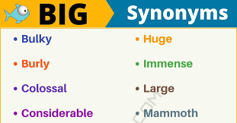
Synonyms of Big

Slide 7

Which one is correct?
He is my huge brother.
He is my big brother.
He is my long brother.
He is my elder brother.

Slide 8
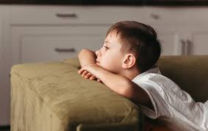
Different words for “Boring”
Dull
Tedious
Monotonous
Uninspiring
Drab
Mundane
Stale
Insipid
Humdrum

Slide 9
Importance of using synonyms
Enhancing Vocabulary
Avoiding Repetition
Precision in Communication
Improving Writing

Slide 10
Tips for using synonyms
Context
matters
Nuance and
Connotation
Context
Practice
Reading
Thesaurus

Slide 11
Examples
1.Abate (to reduce in amount) - Diminish
2.Acerbic (sharp or biting) - Caustic
3.Benevolent (kind and generous) - Altruistic
4.Cacophony (harsh discordance of sound) - Dissonance
5.Debilitate (to weaken) - Enfeeble

Slide 12
6.Ebullient (cheerful and full of energy) - Exuberant
7.Fastidious (very attentive to detail) - Meticulous
8.Garrulous (excessively talkative) - Loquacious
9.Hapless (unlucky) - Unfortunate
10.Impetuous (acting without thought) - Rash

Slide 13
11.Juxtapose (to place side by side for contrast) - Compare
12.Lugubrious (mournful or gloomy) - Somber
13.Mellifluous (sweetly or smoothly flowing) - Harmonious
14.Nefarious (wicked or criminal) - Villainous
15.Obfuscate (to confuse or bewilder) - Confound

Slide 14
16.Perfunctory (carried out with minimal effort) - Cursory
17.Quixotic (idealistic but impractical) - Visionary
18.Recalcitrant (stubbornly resistant) - Defiant
19.Sanguine (optimistic) - Hopeful
20.Tenacious (persistent) - Determined

Slide 15
Can you match the word with its synonym?
Cacophony
Somber
Hapless
Sanguine
Lugubrious
Dissonance
Hopeful
Unfortunate

Slide 16
21.Ubiquitous (present everywhere) - Omnipresent
22.Vapid (offering nothing stimulating) - Insipid
23.Wily (crafty or cunning) - Sly
24.Xenophobic (fearful of foreigners) - Bigoted
25.Yielding (giving way under pressure) - Pliant

Slide 17
26.Zealous (fervent and passionate) - Ardent
27.Adroit (skillful) - Dexterous
28.Bombastic (high-sounding but with little meaning) - Pompous
29.Convivial (friendly, lively) - Sociable
30.Derisive (expressing contempt) - Mocking

Slide 18
Plenary. Use the synonyms for bad to complete this passage.
Late one night I heard a bad noise - what could it be? Was is some bad creature doing a bad deed? As I went to investigate I could smell something bad, and I wondered what bad thing could have happened. All the bad things I could think of filled my mind, and as a I crept round the corner I saw a bad sight…
It was a ______________ !
dreadful horrible terrible awful evil gruesome nasty vile hideous

Slide 19
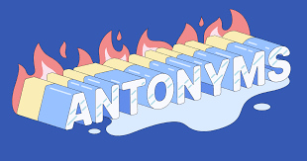

Slide 20
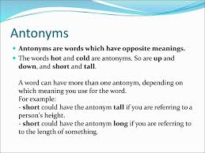

Slide 21
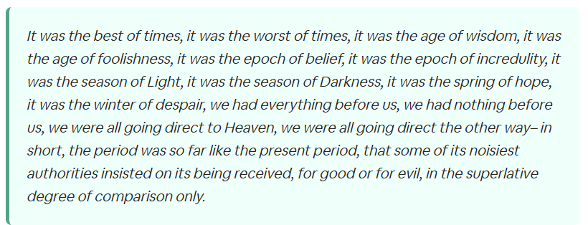
Activity : Identify the antonyms pairs

Slide 22
1.Abate (to reduce in amount) - Intensify
2.Acerbic (sharp or biting) - Bland
3.Benevolent (kind and generous) - Malevolent
4.Cacophony (harsh discordance of sound) - Harmony
5.Debilitate (to weaken) - Strengthen
6.Ebullient (cheerful and full of energy) - Depressed
7.Fastidious (very attentive to detail) - Careless
8.Garrulous (excessively talkative) - Taciturn
9.Hapless (unlucky) - Fortunate
10.Impetuous (acting without thought) - Cautious

Slide 23
Fill in the gap using previously learnt words:
As the construction workers started their machines, a ___________ of noises filled the air, making it impossible to concentrate on anything else.
His _______wit often left his friends laughing, but sometimes his sharp comments could be hurtful.
During the long road trip, their _____companion kept them entertained with endless stories and anecdotes, never allowing a moment of silence

Slide 24
Answer
cacophony
acerbic
garrulous

Slide 25
11.Juxtapose (to place side by side for contrast) - Separate
12.Lugubrious (mournful or gloomy) - Cheerful
13.Mellifluous (sweetly or smoothly flowing) - Harsh
14.Nefarious (wicked or criminal) - Honorable
15.Obfuscate (to confuse or bewilder) - Clarify
16.Perfunctory (carried out with minimal effort) - Thorough
17.Quixotic (idealistic but impractical) - Realistic
18.Recalcitrant (stubbornly resistant) - Compliant
19.Sanguine (optimistic) - Pessimistic
20.Tenacious (persistent) - Yielding

Slide 26
21.Ubiquitous (present everywhere) - Rare
22.Vapid (offering nothing stimulating) - Lively
23.Wily (crafty or cunning) - Naive
24.Xenophobic (fearful of foreigners) - Tolerant
25.Yielding (giving way under pressure) - Resistant
26.Zealous (fervent and passionate) - Apathetic
27.Adroit (skillful) - Clumsy
28.Bombastic (high-sounding but with little meaning) - Reserved
29.Convivial (friendly, lively) - Unfriendly
30.Derisive (expressing contempt) - Respectful

Slide 27
1 | Ubiquitous | Naive
2 | Vapid | Lively
3 | Wily | Clumsy
4 | Xenophobic | Rare
5 | Yielding | Apathetic
6 | Zealous | Tolerant
7 | Adroit | Resistant
8 | Bombastic | Reserved
9 | Convivial | Unfriendly
10 | Derisive | Respectful

Slide 28
Answer
Ubiquitous - D. Rare
Vapid - B. Lively
Wily - A. Naive
Xenophobic - F. Tolerant
Yielding - G. Resistant
Zealous - E. Apathetic
Adroit - C. Clumsy
Bombastic - H. Reserved
Convivial - I. Unfriendly
Derisive - J. Respectful

Slide 29


